Slide 1




Registration
Management System
Registration and Student Card Generation Management System

Slide 2



T E A M
M E M B E R S
BSE-3B
SEMESTER
PROJECT
Hamza
Altaf
------
SP20-BSE-047
Ossama Mehmood
------
SP20-BSE-069
Sara
Sultan
------
SP20-BSE-063
Notes:
Creadit picture : Photo by Anthony Intraversato on Unsplash Link : https://unsplash.com/photos/vYRAP3yMa3I

Slide 3
PAGE
TITLE
Registration and Student Card Generation Management System
Introduction
Documentation
PREPARED FOR
Requirement
Ma’am,
Ayesha Hussain
System Features
&
Modeling Phase
Walia Fatima
User Interference
PREPARED BY
Database Connectivity
Hamza Altaf – Sara Sultan – Ossama Mehmood
Implementation
June 11, 2021
Maintenance
Notes:
Creadit picture : Photo by Ethan Haddox on Unsplash Link : https://unsplash.com/photos/jvUZkoh4Hhw

Slide 4
Introduction
CONTEXT
TABLE OF
Maintenance
&
Performance
Documentation
Introduction
Requirement Engineering
Documentation
--- Functional Requirements
Requirement
--- Non-Functional Requirements
System Features
System Features
Modeling Phase
Modeling & Diagram Phase
User Interference
User Interference Design
Database Connectivity
Implementation
Database Connectivity
Maintenance
Implementation
Notes:
Creadit picture : Photo by Ethan Haddox on Unsplash Link : https://unsplash.com/photos/jvUZkoh4Hhw

Slide 5
Registration
Introduction
Introduction
This Project reviews the relevant research conducted on online student enrollment used by various universities. Includes essentials for online registration such as online registration program, online registration course, and others.
To achieve this goal it is difficult to use the system as information is scattered, it can be cluttered, and collecting relevant information can be time-consuming. It can be used by educational institutions or colleges to maintain student records easily. It also provides a time-consuming process to view, add, edit and delete student marks.
The online registration system will allow online submission of student applications, Student Registrations, Online quiz or test. Saved test results, change student profile.
Documentation
Requirement
System Features
Modeling Phase
User Interference
Database Connectivity
Implementation
Maintenance
Notes:
Creadit picture : Photo by Ethan Haddox on Unsplash Link : https://unsplash.com/photos/jvUZkoh4Hhw

Slide 6
Registration
Documentation
Introduction
In Documentation phase we use to build a strong analysis and requirement gathering of our project.
We use to made several document included
Vision Document
Software Requirements Specification (SRS)
Developed Use Cases
Full Dress Use Cases included in
Documentation with there brief descriptions.
Documentation
Requirement
System Features
Modeling Phase
User Interference
Database Connectivity
Implementation
Maintenance
Notes:
Creadit picture : Photo by Ethan Haddox on Unsplash Link : https://unsplash.com/photos/jvUZkoh4Hhw

Slide 7
Registration
Requirement
Introduction
Requirement are divided into : -
Functional requirements.
Non-functional requirements.
Functional Requirements : -
Storage of student information, including marks and visits
Technical management
Report production
Documentation
Requirement
System Features
Modeling Phase
User Interference
Database Connectivity
Implementation
Maintenance
Notes:
Creadit picture : Photo by Ethan Haddox on Unsplash Link : https://unsplash.com/photos/jvUZkoh4Hhw

Slide 8
Registration
Tool-assisted editing
Student and Admin access
Registration or subscription management
Add/Update/Delete Student Information
Add/Update/Delete Subject Information & field choice Information.
Create/Delete Student and Admin Accounts
Introduction
Documentation
Requirement
System Features
Modeling Phase
User Interference
Database Connectivity
Implementation
Maintenance
Notes:
Creadit picture : Photo by Ethan Haddox on Unsplash Link : https://unsplash.com/photos/jvUZkoh4Hhw

Slide 9
Registration
Non-Functional requirements.
In this system, the authentication of the user is a crucial issue.
During this system, user authentication are going to be done by login by user name and Arcanum and classified by user sort.
Users can get access to the system as permissions square measure classified for that style of user.
Introduction
Documentation
Requirement
System Features
Modeling Phase
User Interference
Database Connectivity
Implementation
Maintenance
Notes:
Creadit picture : Photo by Ethan Haddox on Unsplash Link : https://unsplash.com/photos/jvUZkoh4Hhw

Slide 10
Registration
System Features (Full Dressed Use Cases) : -
In this system, the authentication of the user is a crucial issue.
Title: Enter the goal of the utilization case – ideally as a brief, active phrase.
Description: Describe the goal and context of this use case. This is often sometimes a distended version of what you entered within the “Title” field.
Primary Actor: A person or a software/hardware system that interacts along with your system to attain the goal of this use case.
Pre-conditions: Describe the state the system is in before the primary event during this use case.
Introduction
Documentation
Requirement
System Features
Modeling Phase
User Interference
Database Connectivity
Implementation
Maintenance
Notes:
Creadit picture : Photo by Ethan Haddox on Unsplash Link : https://unsplash.com/photos/jvUZkoh4Hhw

Slide 11
Registration
System Features (Full Dressed Use Cases) : -
Post-condition: Describe the state the system is in in any case the events during this use case have taken place.
Main Success Scenario: As you'll be able to see, this field contains the instance from our previous post – i.e. the flow of events from pre-conditions to post-conditions, once nothing goes wrong.
Introduction
Documentation
Requirement
System Features
Modeling Phase
User Interference
Database Connectivity
Implementation
Maintenance
Notes:
Creadit picture : Photo by Ethan Haddox on Unsplash Link : https://unsplash.com/photos/jvUZkoh4Hhw

Slide 12
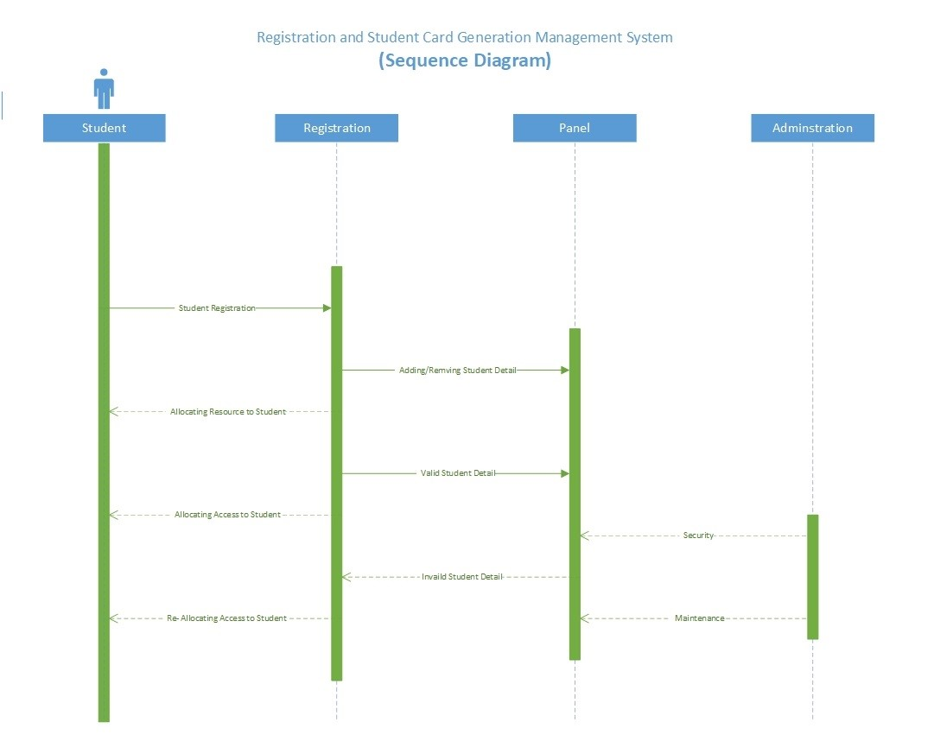
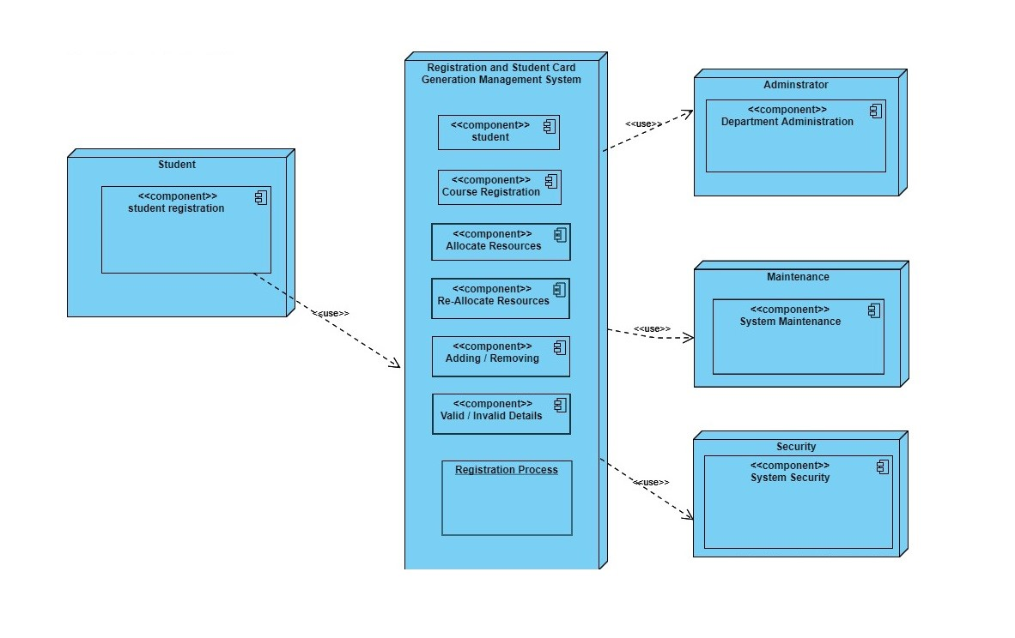
Registration
Modeling Phase
Introduction
Sequence & Deployment Diagram : -
Documentation
In the sequence diagram we build a strong connection between student, registration, panel and administrators.
There's a step followed in a sequence that can bring it back as well as move forward depending on the condition satisfied or not.
It's to build a sequence or a fellow moving backward or forward using nodes.
Requirement
System Features
Modeling Phase
User Interference
Database Connectivity
Deployment Diagram is more towards implementation the component are used to build the relation.
The Student Register and moving forward too whole registration propose with the help of administrator and factors based on maintainability or security.
Implementation
Maintenance
Notes:
Creadit picture : Photo by Ethan Haddox on Unsplash Link : https://unsplash.com/photos/jvUZkoh4Hhw

Slide 13
Registration
User Interference
Introduction
In User Interface Design, We’ll design a login page to access the home interface to perform different operation on the Interface.
Login Page will use to access Home Page.
Documentation
Requirement
System Features
Java Frame (Jframe)
Modeling Phase
We’re using Jframe to design user interface.
Implemented as an instance of the JFrame class, is a window that has decorations such as a border, a title, and supports button components that close or iconify the window.
Applications with a GUI usually include at least one frame
User Interference
Database Connectivity
Implementation
Maintenance
Notes:
Creadit picture : Photo by Ethan Haddox on Unsplash Link : https://unsplash.com/photos/jvUZkoh4Hhw

Slide 14
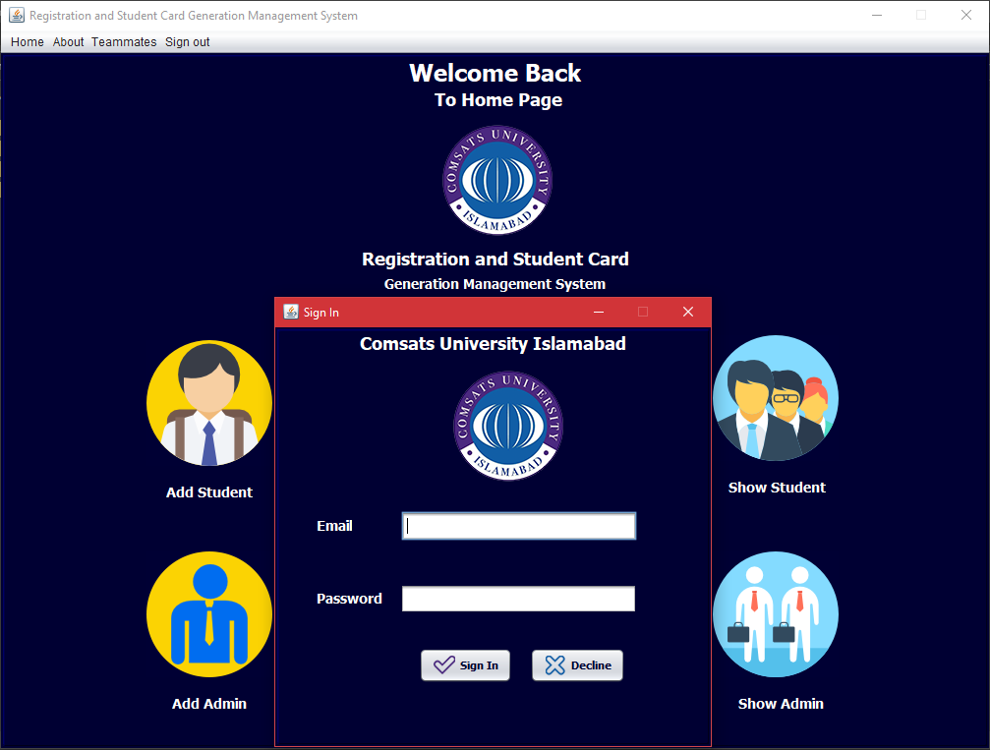
Registration
User Interference
Introduction
Project
Interface
Documentation
Requirement
System Features
Modeling Phase
User Interference
Database Connectivity
Implementation
Maintenance
Notes:
Creadit picture : Photo by Ethan Haddox on Unsplash Link : https://unsplash.com/photos/jvUZkoh4Hhw

Slide 15
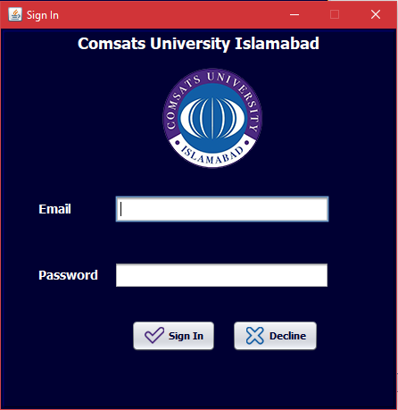
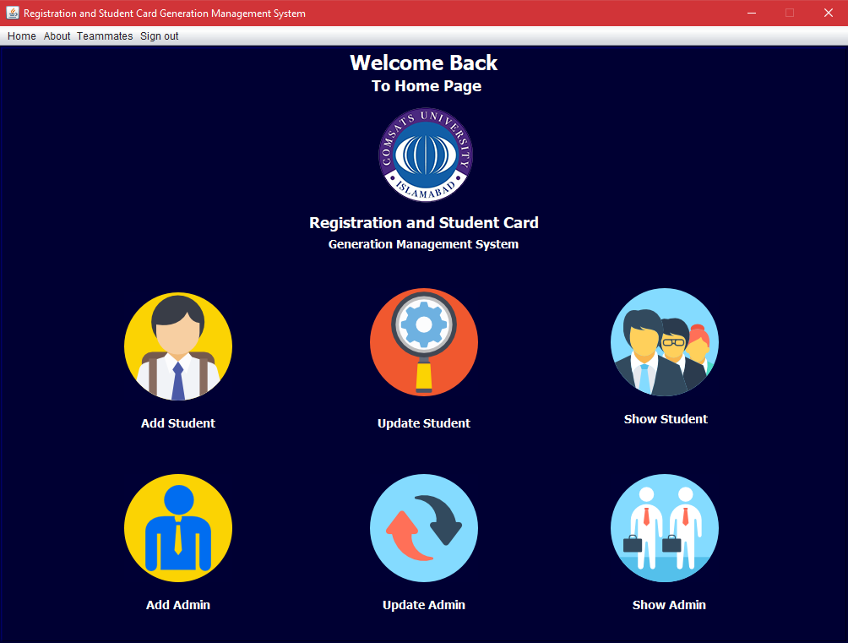
Registration
User Interference
Introduction
Login
Page
Home
Page
Documentation
Requirement
System Features
Modeling Phase
User Interference
Database Connectivity
Implementation
Maintenance
Login Page Interface
Login Page will use to access Home Page.
Home Page Interface
Home Page will use to access all functionalities.
Notes:
Creadit picture : Photo by Ethan Haddox on Unsplash Link : https://unsplash.com/photos/jvUZkoh4Hhw

Slide 16
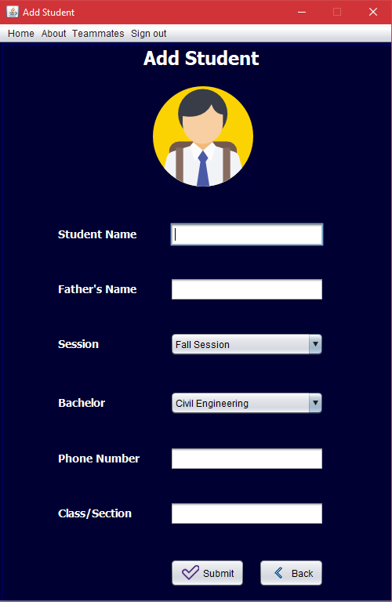
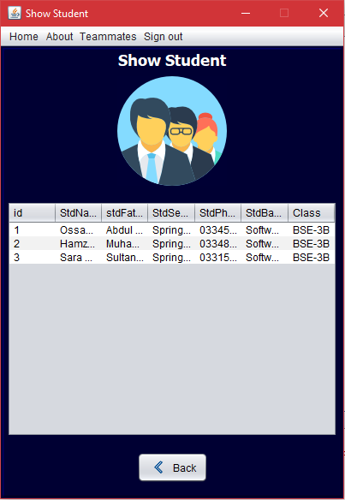
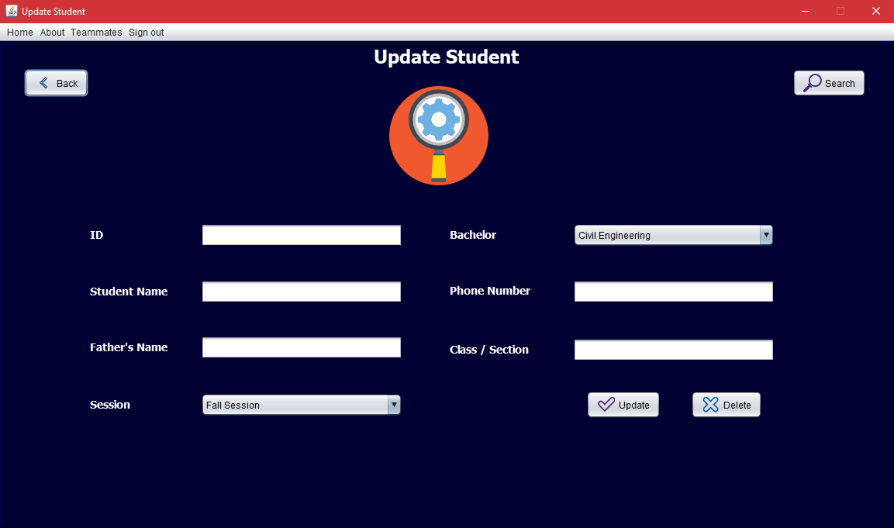
Registration
User Interference
Introduction
Add
Student
Update
Student
Show
Student
Documentation
Requirement
System Features
Modeling Phase
User Interference
Database Connectivity
Implementation
Maintenance
Student Interface
Add, Update/Delete/Search and Show Student
Notes:
Creadit picture : Photo by Ethan Haddox on Unsplash Link : https://unsplash.com/photos/jvUZkoh4Hhw

Slide 17
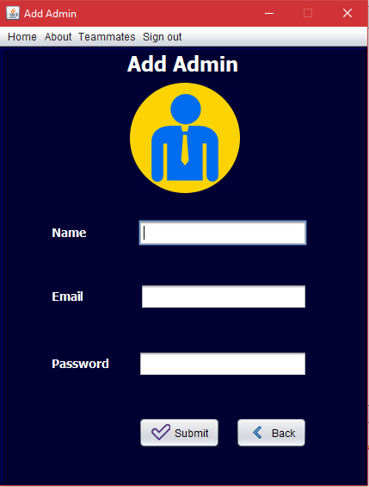
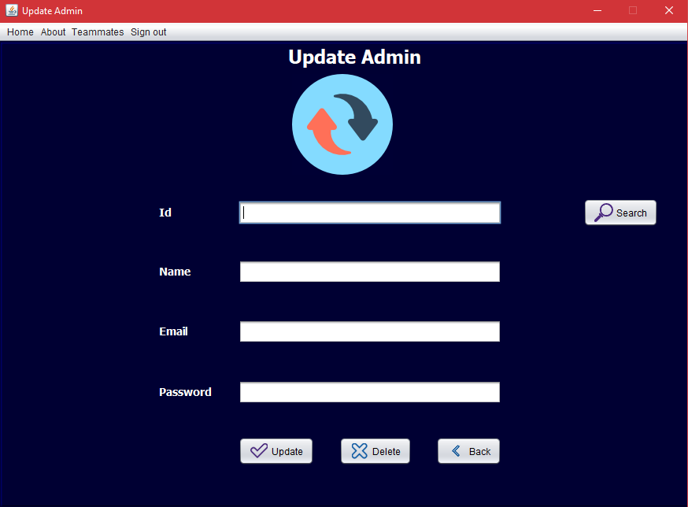
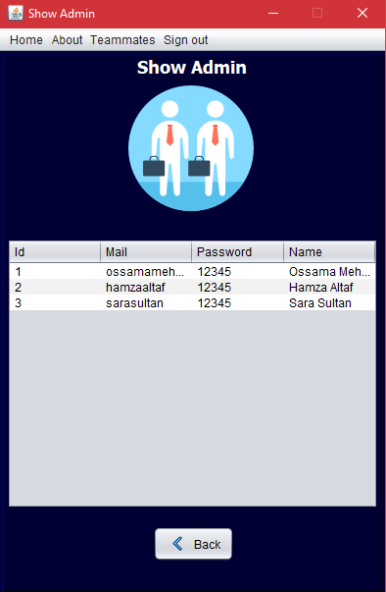
Registration
User Interference
Introduction
Add
Admin
Update
Admin
Show Admin
Documentation
Requirement
System Features
Modeling Phase
User Interference
Database Connectivity
Implementation
Maintenance
Admin Interface
Add, Update/Delete/Search and Show Admin
Notes:
Creadit picture : Photo by Ethan Haddox on Unsplash Link : https://unsplash.com/photos/jvUZkoh4Hhw

Slide 18
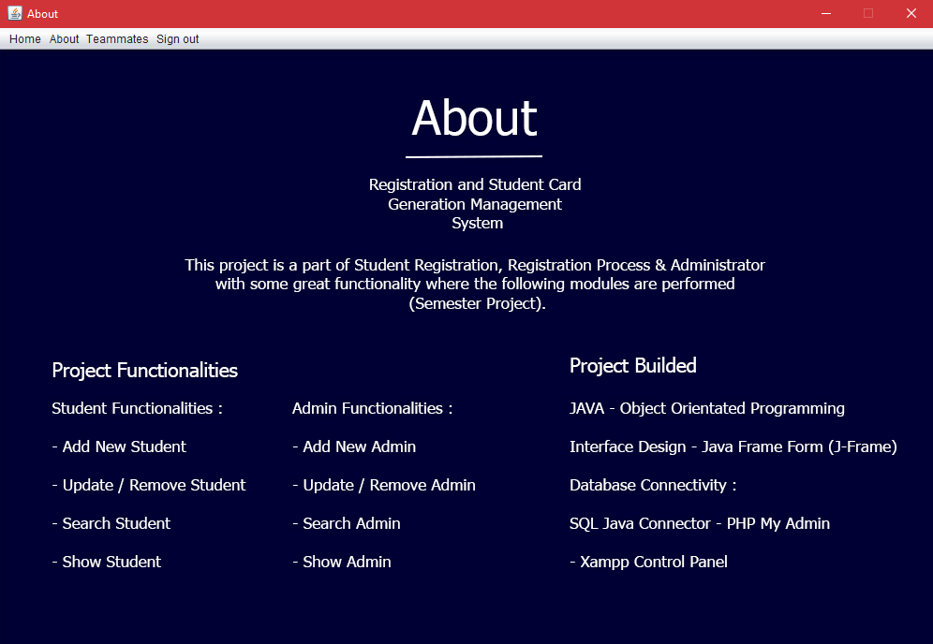
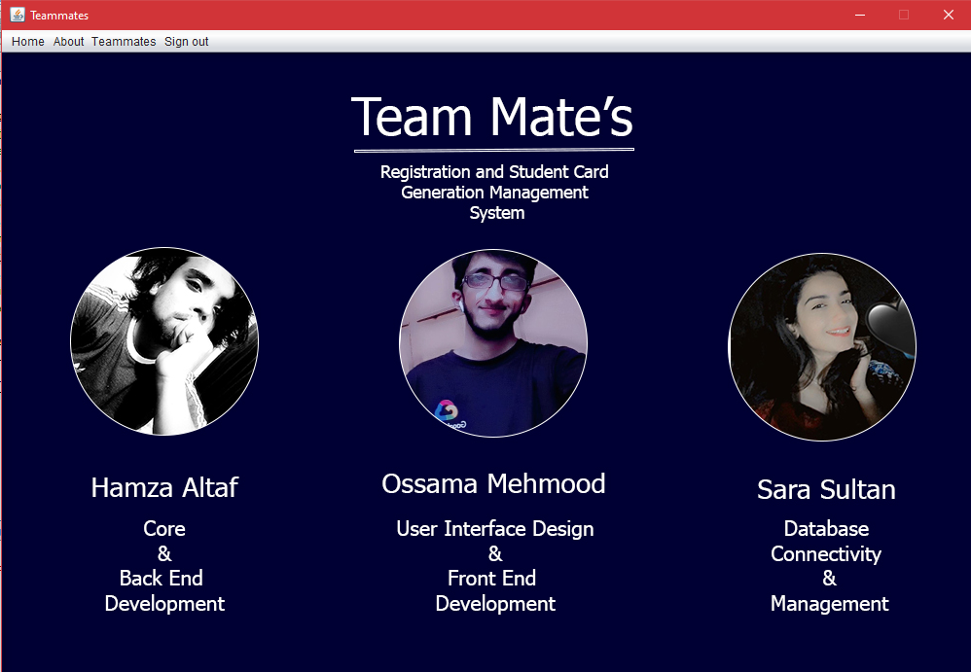
Registration
User Interference
Introduction
About
Page
Teammates
Page
Documentation
Requirement
System Features
Modeling Phase
User Interference
Database Connectivity
Implementation
Maintenance
About and Teammates
About and Teammates Page Interface
Notes:
Creadit picture : Photo by Ethan Haddox on Unsplash Link : https://unsplash.com/photos/jvUZkoh4Hhw

Slide 19
Registration
Database Connectivity
Introduction
Documentation
PHP My Admin :
We’re using Localhost – Php My Admin – Online Database to store details.
We used SQL Connector to build connection between database and NetBeans.
We use XAMPP Control Panel to access Database phpmyadmin.
We’re storing Student, Admin and there registration details there.
We’re able to Add/Update/Delete - Student/Admin details directly from Database as well as from our Registration Management System.
Requirement
System Features
Modeling Phase
User Interference
Database Connectivity
Implementation
Maintenance
Notes:
Creadit picture : Photo by Ethan Haddox on Unsplash Link : https://unsplash.com/photos/jvUZkoh4Hhw

Slide 20
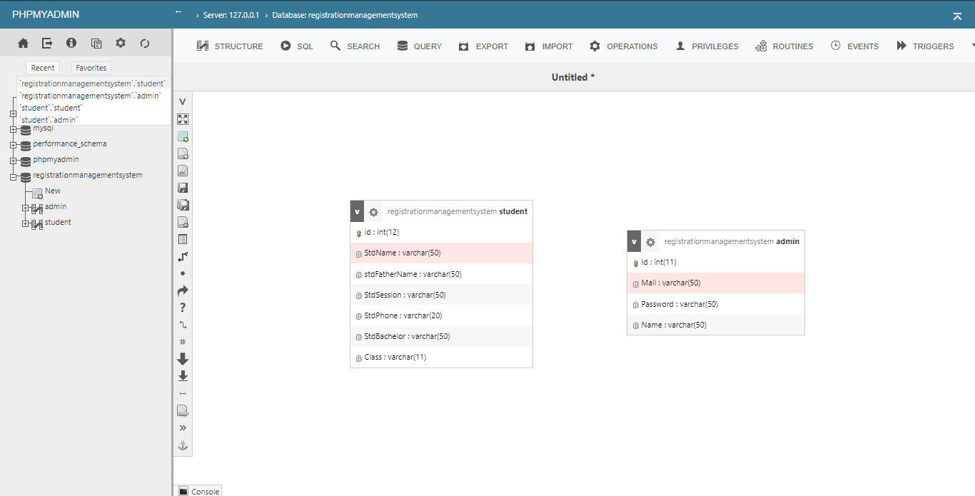
Registration
Database Connectivity
Introduction
Documentation
Requirement
System Features
Modeling Phase
User Interference
Database Connectivity
Implementation
Maintenance
Access Our Database Here
http://localhost/phpmyadmin
Notes:
Creadit picture : Photo by Ethan Haddox on Unsplash Link : https://unsplash.com/photos/jvUZkoh4Hhw

Slide 21
Registration
Implementation
Introduction
In Implementation phase we use to code or developed the Registration Management System
Implementation will be performing using NetBeans
We’re using Jframe with implementation to design a user friendly interface as well with implementation.
We’re using Phpmyadmin (Localhost) for storing Student, Admin and Registration details.
Documentation
Requirement
System Features
Modeling Phase
User Interference
Database Connectivity
Implementation
Maintenance
Notes:
Creadit picture : Photo by Ethan Haddox on Unsplash Link : https://unsplash.com/photos/jvUZkoh4Hhw

Slide 22
Registration
Maintenance
Introduction
In Maintenance , We use to deals with different factors that help use to toward improvement in performance.
Delete irrelevant content and store old content elsewhere
Purge inactive users
Schedule version or system updates and down time
Reorganize modules in a logical order
Cut out the “fluff”
Documentation
Requirement
System Features
Modeling Phase
User Interference
Database Connectivity
Implementation
Maintenance
Notes:
Creadit picture : Photo by Ethan Haddox on Unsplash Link : https://unsplash.com/photos/jvUZkoh4Hhw

Slide 23
THANK YOU SO MUCH
Ma’am Ayesha & Walia
From: (SP20) - BSE 3B - (Group Mate)
Hamza Altaf (048), Sara Sultan (063), Ossama Mehmood (069)

